Slide 1

ChefPal
Group 9
Shahir Ghani
Malena Bashar
Dymytriy Zyunkin
Daniel Samojlik
Amanda Phan
Michael Fong
Malak Khalifa
Aswathy Aji
Azim Khan
Nirav Patel

Slide 2
Overview
Target Audience:
Anyone and everyone will be able to operate ChefPal, as long as they have a mobile device
People low on time, money, and in need of making recipes with the ingredients that they have is our main focused group currently (Ex. College students, college graduates)
What is ChefPal for?:
ChefPal is meant to allow users to produce recipes by selecting dietary restrictions, preferences, and current ingredients
If a user is missing an ingredient for their recipe, ChefPal will locate a nearby grocery store with those missing ingredients
Provides users who have strict dietary restrictions and preferences an option to explore more recipes that they may be unfamiliar with
Give users an opportunity to explore different palettes with various recipes offered to them
Make life for users a little bit easier when it comes to choosing what to eat

Slide 3
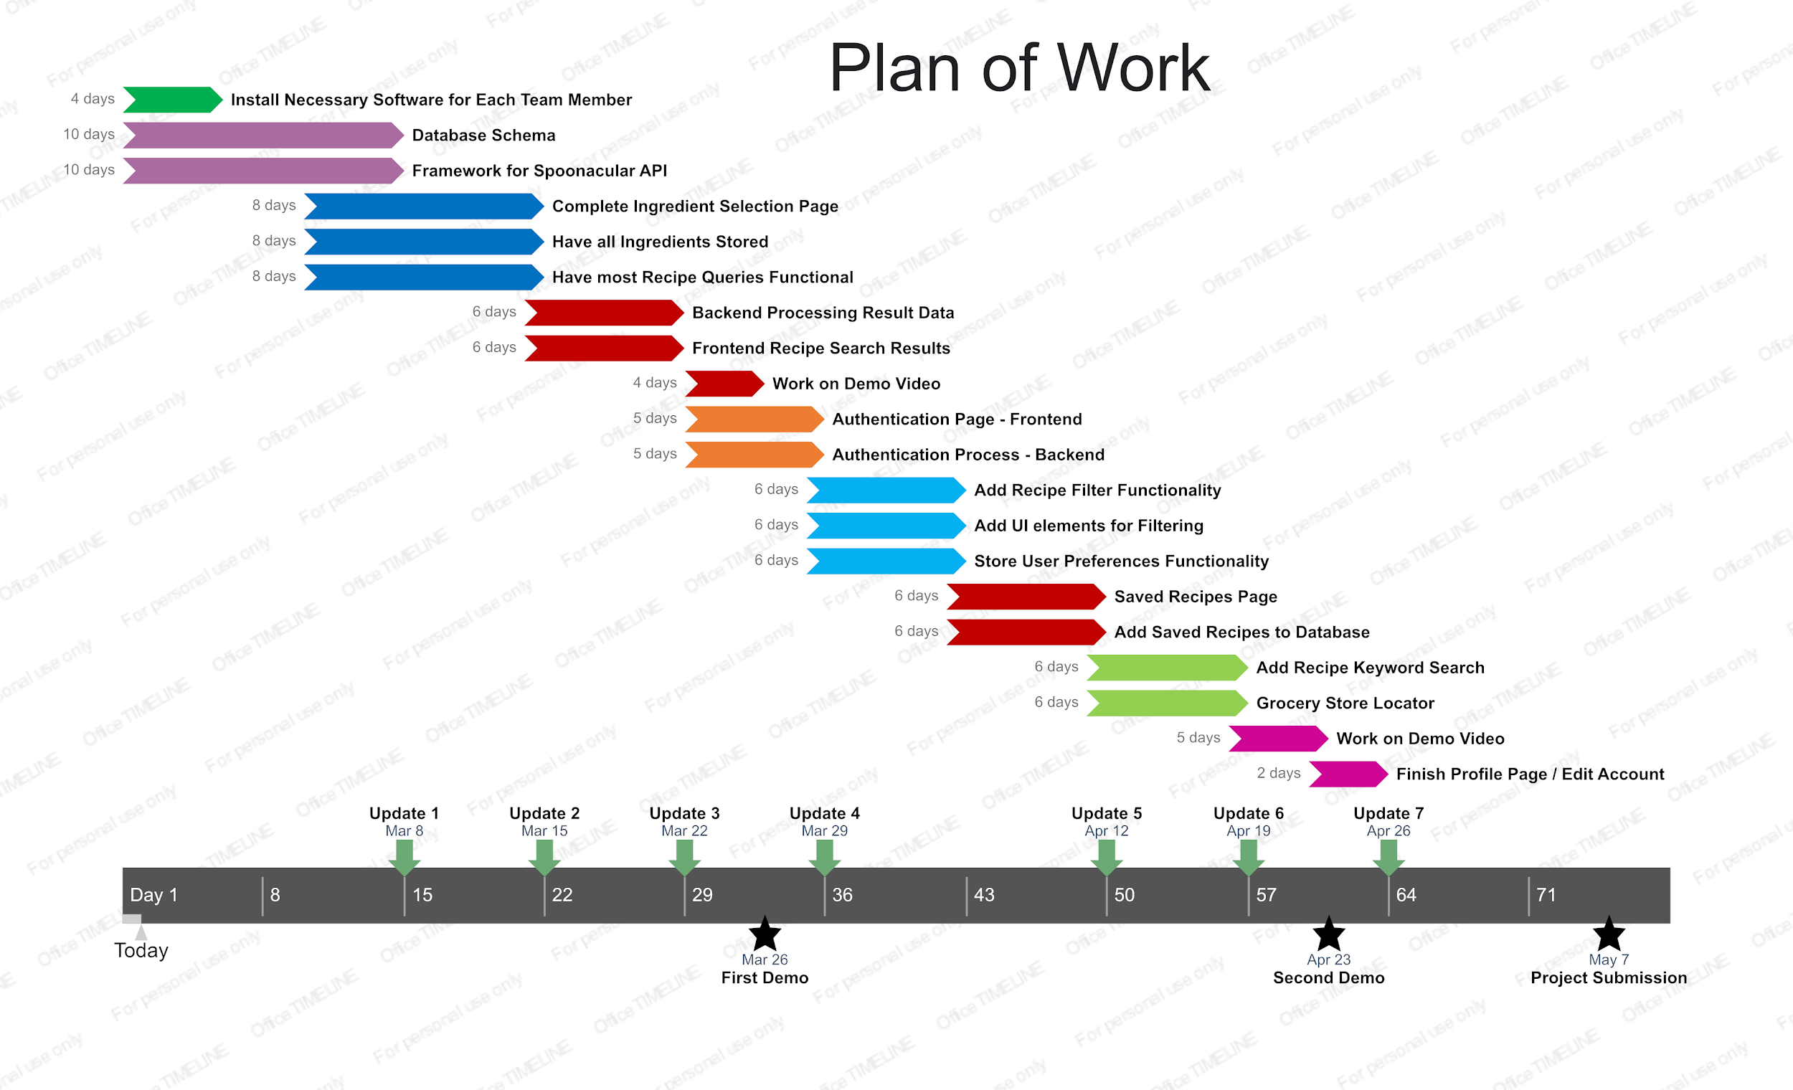
Roadmap
Notes:
Highlight the key steps
Recipe search, ingredient select, database connection, authentication, filtering, saving recipes, grocery store locator

Slide 4
Key Features/Functions
Newly Implemented
Grocery Store Locator
User selects missing ingredients and system locates store
Google Maps API implemented
Dietary Restrictions and Preferences
User will check off boxes that apply to themselves and their needs
Recipe Filtering Functionality
User can filter recipes down to be more specific by checking off boxes that they would like to have
Saved Recipes Page
User presses like button on recipe and is saved in favorites tab on navigation page
User Interface
Fully operational for user in order to interact with ChefPal
User Info Stored on Database
Connected mobile app to Firebase to store user’s info
Authentication for Frontend and Backend
System will only allow registered users access to app
Previously Implemented
Log-in Page
Enter user email and password if already registered
Registration Page
User will enter information, along with dietary restrictions and preferences (Wasn’t working then)
Drop Down Menu to Input User’s Ingredients
User will check off boxes on ingredients that they currently have at their disposal
Framework for Navigation of ChefPal
Allows for user to navigate app through navigation bar at bottom of screen for ease of use
Spoonacular API implemented
Keyword Recipe Search
Allows users to search for specific meals/recipes with ease through use of a search bar
Notes:
Briefly describe what the function does
Demonstrate how the user will use it
Highlight important aspects, such as user interface design , what is happening at the application’s back end

Slide 5
DEMO
Notes:
Most important: Do not only show what the user could do manually with your system; show also what the system can do automatically -- what are the “smarts” of your system that are worth noticing? What kind of automatic data processing your system does?
Automation is not when the user does most of the thinking and work to get even simple tasks accomplished. User’s effort, in terms of remembering what system input currently is appropriate, the range of acceptable inputs, the number of clicks and keystrokes necessary for task completion, etc., must be minimized. During your presentation, explicitly highlight such features of your system.
The most important thing for the demo is that you want to impress the audience with your technical achievement for this semester. You want to impress the audience that:
You are addressing an important problem
The problem presents technical challenges, which you have successfully addressed
Your solution employes sophisticated software engineering techniques
This product is easy to understand and operate/use
This product is reliable and professionaly developed

Slide 6
Future Work
What else can be implemented?
Adding quantity for ingredient selection for better recipe generation
Listing the price of missing ingredients for recipes from the listed grocery stores
Suggested recipes based on frequent recipes generated by the user
Directions to the grocery store with the missing ingredients that the user selected
Additional filtering for grocery store locator, like the kind of grocery store (Asian, Indian, etc)
How can we make the app better?
Having recipes be generated by what recipes/ingredients the user selects frequently or recently to make it more focused on the user
Having generated recipes be more specific to the user and more accurate to the exact amount of ingredients that the user has and needs

Slide 7
Thanks for Watching

